Slide 1
Objectives, methods, deliverables
Christopher I. Macintosh, PhD, RN
Notes:
Hello everyone
My name is Chris Macintosh. I help teach the capstone courses.
Today we’re talking about defining the methods and deliverables that you plan to use to meet your project objectives.
[Next slide]

Slide 2
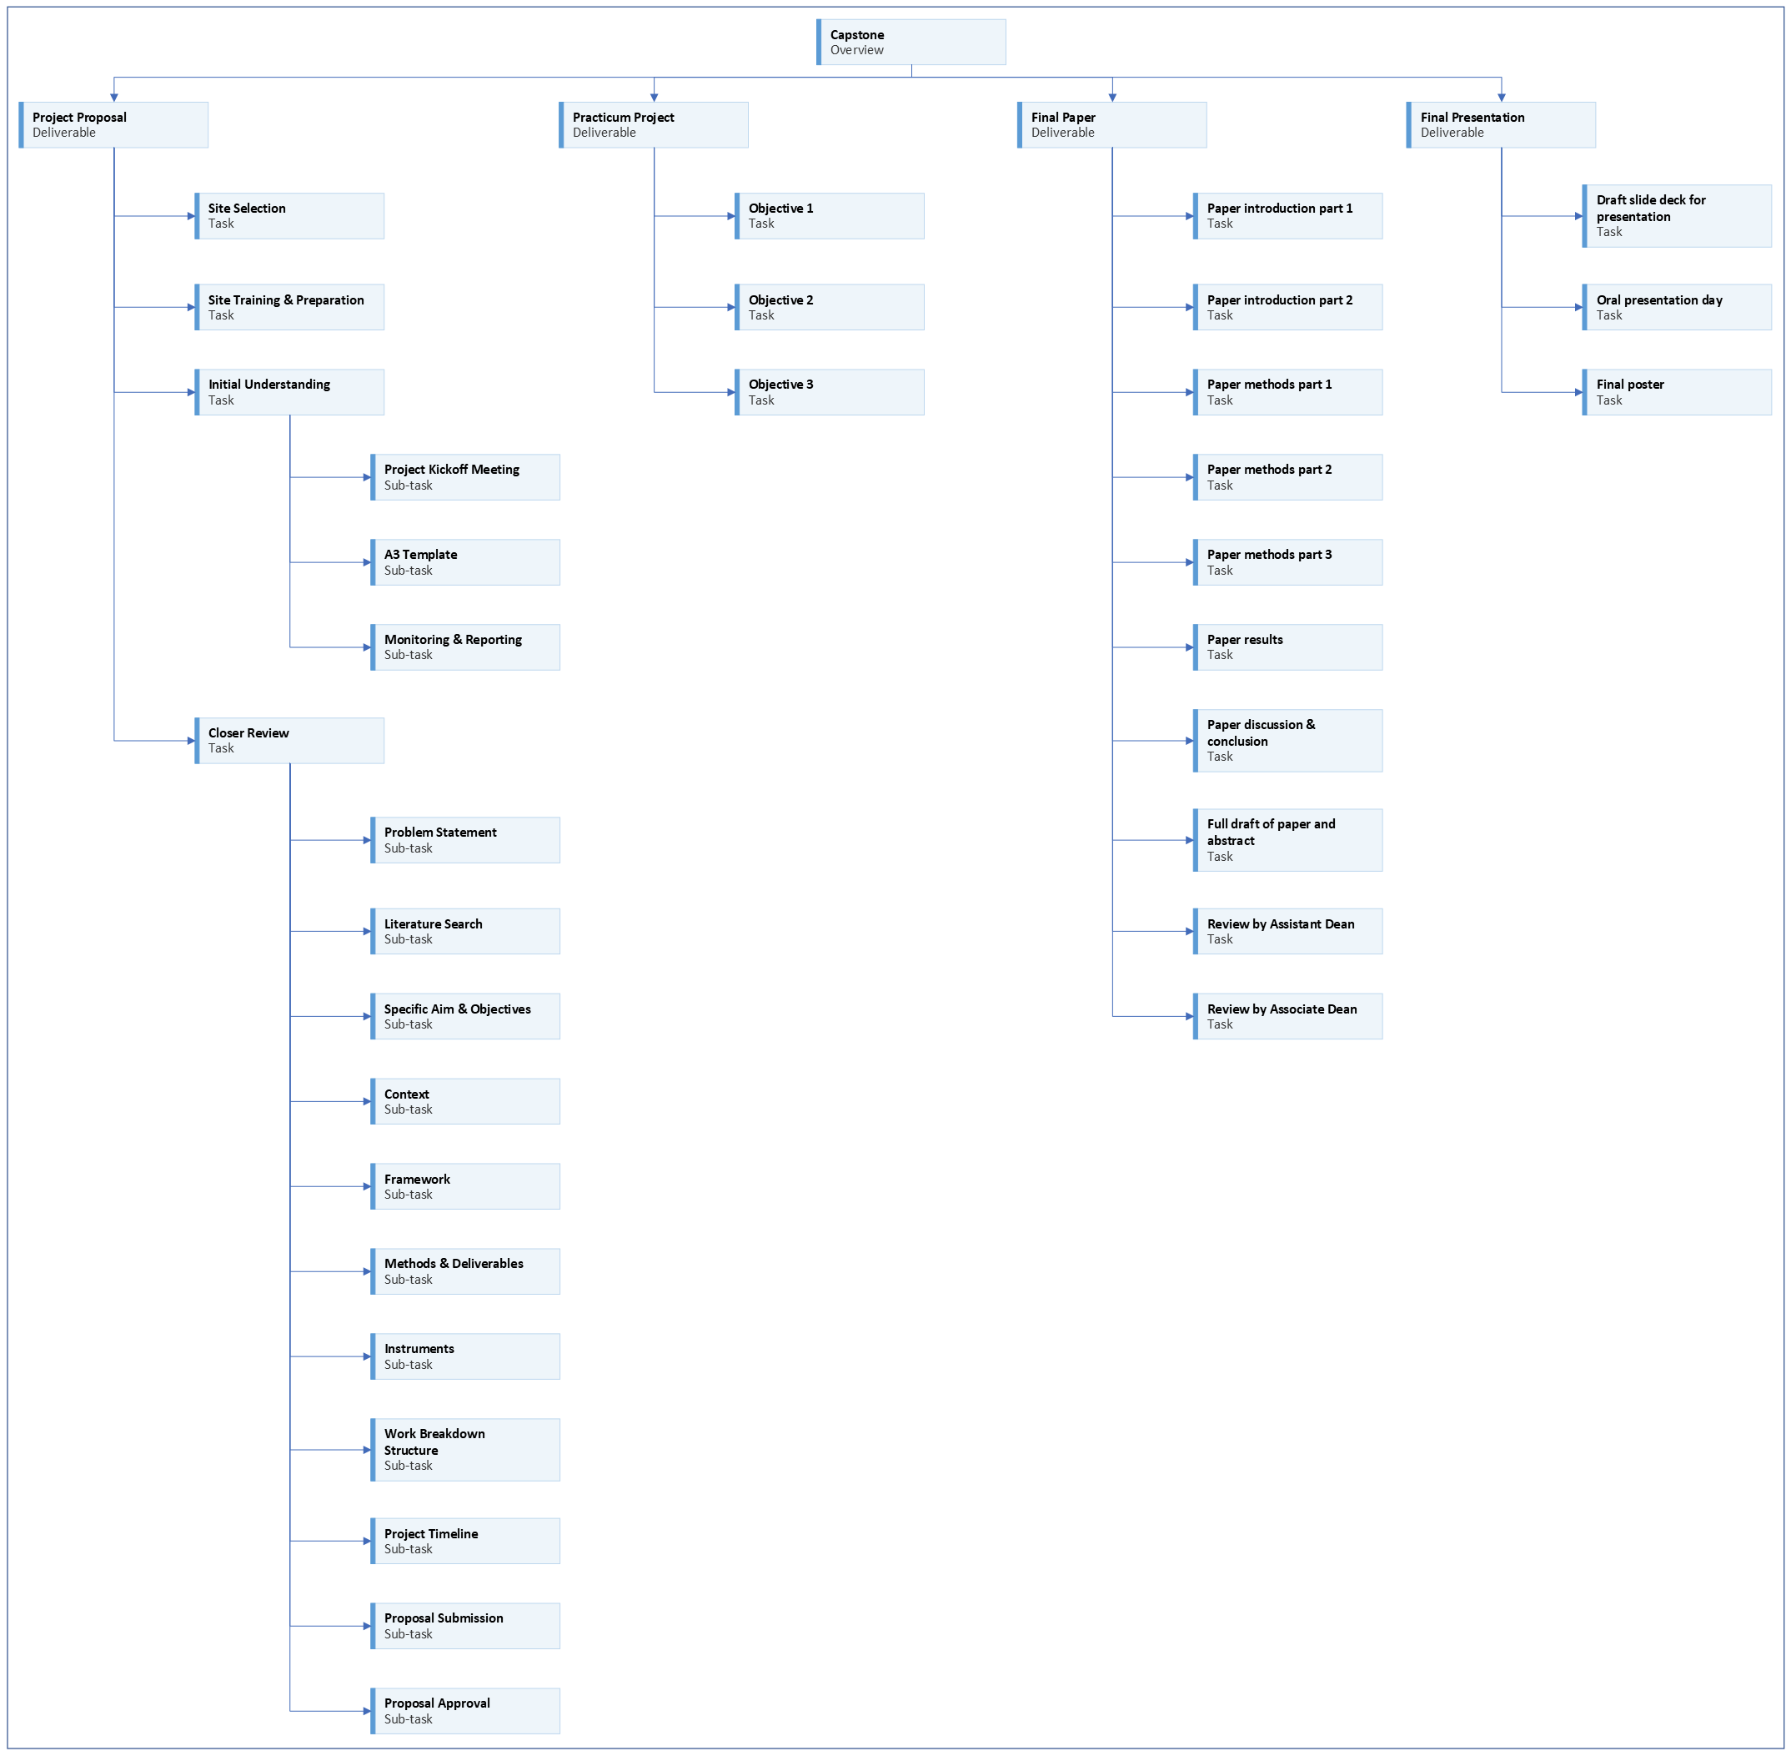
Notes:
[click]
We are working on the project proposal portion of your capstone experience.
[Next slide]

Slide 3
Notes:
Last time we talked about selecting a framework, model, or theory to guide your project.
[Next slide]

Slide 4
Notes:
Today we will talk about the methods and deliverables for your project objectives.
[Next slide]

Slide 5

Address feedback
Notes:
You should be addressing any feedback on your assignments and pasting updated content in the appropriate sections.
[next slide]

Slide 6
Objective | Method(s) Describe using verbs | Product/Outcome Describe using nouns
Assess | Reviewing, surveying, mapping, analyzing, auditing, conducting, comparing, benchmarking | Descriptions, summaries, reports, analyses, reviews
Develop | Create, develop, produce, design, assemble, formulate, write, organize, generate, devise, prepare | Guidelines, protocols, algorithms, tools, instruments, diagrams, resources, plans
Implement | Execute, demonstrate, present, deliver, set up, schedule, use, maintain | Improvements, increases, reductions, enhancements, efficiency, savings, standardization, enhance
Evaluate | Test, check, review, survey, collect, get feedback, benchmark, observe, audit | Results, conclusions, reports, analyses
Notes:
I’m going to talk about methods and deliverables in terms of some concrete examples for different types of objectives.
Here is a table listing four objectives: Assess, Develop, Implement, Evaluate.
These may or may not match your objectives. This is just a hypothetical example.
If you look in the Methods column in the middle, there are example of action words.
What are you going to DO to reach your product objectives?
If you look in the Product/Outcome column on the right, there are examples of things you may produce.
[next slide]

Slide 7
Action words & Example objectives
Bloom’s Taxonomy
https://cte.utah.edu/instructor-education/Blooms-Taxonomy.php
Graduate Nursing Projects
See MS and DNP project papers
https://library.med.utah.edu/publishing/collection/graduate-nursing-project/
Notes:
Bloom’s Taxonomy is used in education contexts, but it’s a nice source of some action words to get you thinking about action words for methods.
You can also look at other student project papers.

Slide 8
Assess objective example
Objective | Method | Product/Outcome
Assess provider knowledge and interest in opioid prescribing changes and identify opioid prescribing rates. | Use an open-ended survey to assess providers’ knowledge, interest, and attitudes about opioid education. Use EHR reporting tool to get provider prescribing practices and rates. | Summary of common themes from the survey. Descriptive statistics of opioid prescribing rates.
Notes:
Here’s an assess objective example.
Read
[next slide]

Slide 9
develop objective example
Objective | Method | Product/Outcome
Develop an opioid clinical practice guideline that is specific to the needs of the clinic. | Create the clinical practice guideline based on survey results and chart review. Create education material about the CPG. | Clinical practice guideline PowerPoint presentation Printed reference material Electronic copy of reference material
Notes:
Here’s a develop objective example.
Read
[next slide]

Slide 10
implement objective example
Objective | Method | Product/Outcome
Implement the opioid clinical practice guideline. | Deliver the training during the monthly clinic meeting including PowerPoint, handouts, and group discussion. | Completed training session. Participant presentation evaluations.
Notes:
Here’s an implement objective example.
Read
[next slide]

Slide 11
evaluate objective example
Objective | Method | Product/Outcome
Evaluate the feasibility, usability, and satisfaction of the effectiveness of decreasing the frequency and dose of opioid prescribing. | Survey providers using a structured questionnaire regarding the feasibility, usability, and satisfaction with the CPG. Ask about barriers and facilitators to continued use of the CPG. Collect post-intervention EHR data regarding prescribing rates. | Descriptive statistics from survey data. Analysis of prescribing rate change statistics.
Notes:
Here’s an evaluate objective example.
Read
[next slide]

Slide 12
Evaluation
Feasibility, Usability, & Satisfaction
Notes:
A lot of quality improvement projects include evaluation objectives.
Many of them focus on evaluating feasibility, usability, and satisfaction.
The following slides have some questions to think about.
[next slide]

Slide 13
Feasibility
Did the project provide sufficient value?
Is the project viable?
Is the project likely to succeed?
Are there resources to support the continuation of the project?
Do the benefits outweigh the costs/risks?
Is there intent to continue to use the project in the future?
Notes:
Here are some questions about feasibility.
Read
[next slide]

Slide 14
usability
How usable is the project?
Can users achieve the desired goals?
How quickly can users achieve goals?
How easy is it for users?
How easy is it for users to remember?
Notes:
Here are some questions about usability.
Read
[next slide]

Slide 15
usability
What were the facilitators and barriers of the project?
What is the success rate for users?
How much time did it take to complete the intervention?
What is the error rate? How many mistakes do users make?
Notes:
You might also consider these questions about usability.
Read
[next slide]

Slide 16
satisfaction
Were the users satisfied?
Would the users recommend the intervention to others?
What did users dislike?
Notes:
Here are some questions about satisfaction.
Read
[next slide]

Slide 17
Review objectives
Are objectives…
Measurable?
Achievable?
Realistic?
Notes:
This is a good time to review your objectives
[click]
Are they measurable, achievable, and realistic?
[next slide]

Slide 18
Literature
Is there any literature that shows what methods have been used to address your problem?
Is there any literature that reports outcomes when problems similar to yours have been addressed? (positive or negative outcomes)
Notes:
You should also look to see if there’s any literature published that may support your methods.
[click]
What methods have been used with this kind of problem?
[click]
What kind of outcomes have been reported?
[next slide]

Slide 19



assignment
Notes:
[click]
Your assignment is to create your Objectives-Methods-Deliverables table.
[click]
Find literature that may support your methods.
What methods have been used with your problem?
What have the outcomes been?
[next slide]

Slide 20




Writing tip
Notes:
I will reiterate the writing tips.
The Objective-Methods-Deliverables assignment will eventually become the Intervention section of your project manuscript.
Information for Evaluate Objectives will become part of the Study of the Intervention section of your project manuscript.
[click]
The more writing you can do this semester; the easier next semester will be.
[click]
Eventually I will be looking for well-formed paragraphs with topic sentences and supporting statements.
[click]
One way to check for well-formed paragraphs is try reverse outlining.
After you write your paragraph, highlight your topic sentence.
(I usually like to use light-gray to highlight topic sentences.)
Then check to see if the supporting statements in the paragraph support the topic sentence.
If they don’t all seem to support the topic sentence, then you need to write a broader topic sentence or split the paragraph into different paragraphs with separate topics.
[next slide]

Slide 21

More to come . . .
Notes:
That’s all we’ll do in this video.
There is more to come.
[next slide]

Slide 22
References

